Slide 1

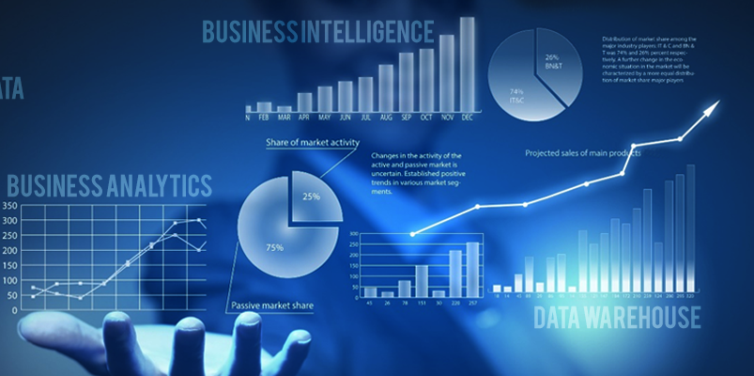
BUSINESS INTELLIGENCE
CHAPTER 1
Business Intelligence: Carlo Vercellis

Slide 2
Definition of BI:- Set of mathematical models and analysis methodologies that exploit the available data to generate information and knowledge useful for complex decision making process.
Today’s Scenario:
  Low cost data storage technologies
  Availability of internet
  Heterogeneous data
  Need to convert data into information
Sudha Bhagavatheeswaran, Department of Information Technology,
SIES College of Arts, Science & Commerce (Autonomous)

Slide 3

DECISIONS
Eg 1:- Retention in mobile industry
Eg 2:- Logistics Planning
EFFECTIVE AND TIMELY
Sudha Bhagavatheeswaran, Department of Information Technology,
SIES College of Arts, Science & Commerce (Autonomous)

Slide 4
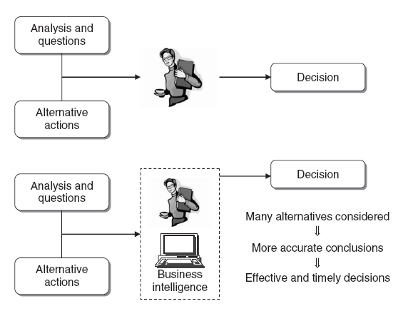
Benefits of a Business Intelligence System
Sudha Bhagavatheeswaran, Department of Information Technology,
SIES College of Arts, Science & Commerce (Autonomous)

Slide 5
DATA
INFORMATION
KNOWLEDGE
Sudha Bhagavatheeswaran, Department of Information Technology,
SIES College of Arts, Science & Commerce (Autonomous)

Slide 6
The role of mathematical models
Identify objectives of analysis
Identify performance indicators
Develop Mathematical models
what-if analysis to evaluate the effects on the performance
Sudha Bhagavatheeswaran, Department of Information Technology,
SIES College of Arts, Science & Commerce (Autonomous)

Slide 7
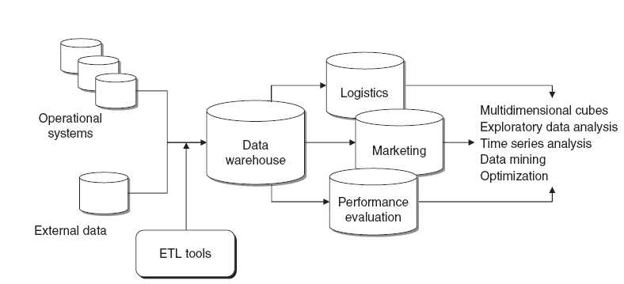
Business Intelligence Architectures
Sudha Bhagavatheeswaran, Department of Information Technology,
SIES College of Arts, Science & Commerce (Autonomous)

Slide 8
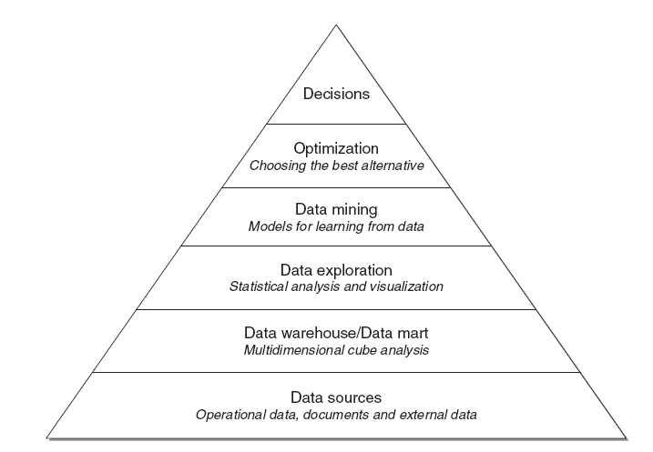
Main Components of BI System
Sudha Bhagavatheeswaran, Department of Information Technology,
SIES College of Arts, Science & Commerce (Autonomous)

Slide 9
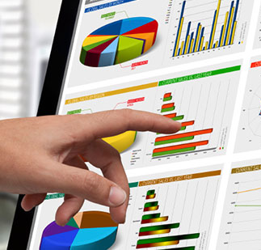
Enabling factors in BI projects
Technologies
Analytics
Human Resources
Sudha Bhagavatheeswaran, Department of Information Technology,
SIES College of Arts, Science & Commerce (Autonomous)

Slide 10
BI -ANALYSIS CYCLE
ANALYSIS
INSIGHT
DECISION
EVALUATION
Sudha Bhagavatheeswaran, Department of Information Technology,
SIES College of Arts, Science & Commerce (Autonomous)

Slide 11
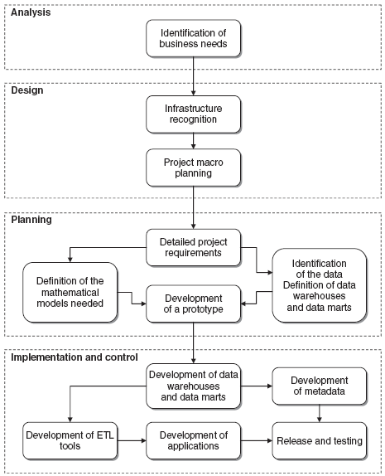
Development of a business intelligence system
Sudha Bhagavatheeswaran, Department of Information Technology,
SIES College of Arts, Science & Commerce (Autonomous)

Slide 12
Ethics and Business Intelligence
Usage of improper data or violation of right to privacy not to be tolerated.
Guard against political and economic influence
Questions:-
  Is it right to develop an optimization model on distributing costs on an international scale in order to circumvent the tax systems of certain countries?
  Is it legitimate to make a decision on the optimal position of the tank on a vehicle to minimise costs, which may cause serious harm to passengers in event of collision?
Sudha Bhagavatheeswaran, Department of Information Technology,
SIES College of Arts, Science & Commerce (Autonomous)

